Slide 1
Lecture 12. Advanced
Data Structures (1)
Instructor: 黄群
huangqun@pku.edu.cn
School of EECS
Peking University
Notes:
黄祎程，王潇放，潘晨毅，陈东维、李家耀

Slide 2
Outline
Multi-array
Generalized list
Storage management
Trie

Slide 3
Multi-Array: Concepts
Array (数组) is a data structure consisting a collection of elements, each identified by index
A static array
Type and size specified at definition time
A dynamic array
Allocated during runtime

Slide 4
Multi-Array: Concepts
Multi-array (多维数组) is an extension of array
An array of arrays
An n-dimensional array can be written as
Elem A[c₁…d₁][c₂…d₂]…[c_{n}…d_{n}]
c_{i} and d_{i} are the lower bound and upper bound of indices at the i-th dimension
The total number of elements is

Slide 5
Multi-Array: Spatial Structure
d₁[1..3], d₂[1..5], d₃[1..5] are the three dimensions
2-D array 3-D array

Slide 6
Multi-Array: Storage
The memory is one-dimensional, so is the storage of a multi-array
Row majored (行优先)
Column majored (列优先)

Slide 7
Multi-Array: Storage
Arrays in C/C++, Pascal are row-majored
Arrays in Matlab, Fortran are column-majored
Notes:
The Origins of MATLAB
http://www.mathworks.com/company/newsletters/articles/the-origins-of-matlab.html
Stanford CS237, LINPACK, etc.

Slide 8











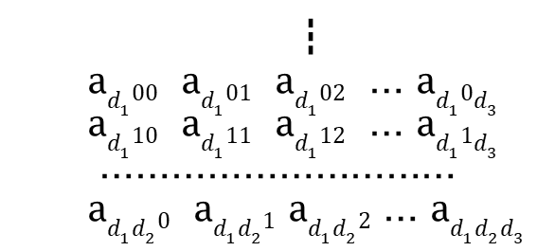


Locate Element
Example: locate a₁₁₂
A multi-array in C++: Elem A[d₁][d₂]…[d_{n}]
a₀₀₁ a₀₀₂ … a₀$0d_{3}$
a₀₀₀
$$a_{1∗∗}$$
a₀₁₁ a₀₁₂ … a₀$1d_{3}$
+$1∗d_{2}d_{3}$
a₀₁₀
…………………………
a₀$d_{2}$₀
a₀$d_{2}$₁ a₀$d_{2}$₂ … a₀$d_{2}d_{3}$
$$a_{11∗}$$
+$1∗d_{3}$
a₁₀₀ a₁₀₁ a₁₀₂ … a₁₀$d_{3}$
a₁₁₀ a₁₁₁ a₁₁₂ … a₁₁$d_{3}$
$$a_{112}$$
…………………………
+$2$
a₁$d_{2}0$ a₁$d_{2}1$ a₁$d_{2}2$ … a₁$d_{2}d_{3}$
┇ a$d_{1}00$ a$d_{1}01$ a$d_{1}02$ … a$d_{1}0d_{3}$ a$d_{1}10$ a$d_{1}11$ a$d_{1}12$ … a$d_{1}1d_{3}$ ………………………… a$d_{1}d_{2}0$ a$d_{1}d_{2}1$ a$d_{1}d_{2}2$ … a$d_{1}d_{2}d_{3}$
d is size of element

Slide 9
Arrays for Special Matrices
Triangular matrices
lower-triangular
upper-triangular
Symmetric matrices
Diagonal matrices
Sparse matrices

Slide 10
Lower-Triangular Matrices
1-D array L[0…(n²+n)/2-1]
Store a_{i,j} at L[(i²+i)/2+j] (i≥j)

Slide 11
Symmetric Matrices
Definition: a_{i,j}=a_{j,i} for 0 ≤ i,j < n
e.g., the adjacency matrix of a undirected graph
Storage of its lower-triangular part is enough
1-D array S[0…(n²+n)/2-1]
Store a_{i,j} at S[k], where

Slide 12
Diagonal/Banded Matrices
Non-zero entries are confined to a diagonal band, comprising
the main diagonal
zero or more diagonals on either side
A example of a banded matrix with bandwidth=3
If |i-j| > 1，a[i][j] = 0
a_{0,0}
a_{0,1}
……
0
a_{1,0}
a_{1,1}
a_{1,2}
……
……
a_{n-2,n-1}
0
a_{n-1,n-2}
a_{n-1,n-1}

Slide 13
Sparse Matrices
A matrix populated primarily with zeros
0
0
0
0
0
0
0

Slide 14
Sparse Matrices
Sparse factor
Assume there are t non-zero entries in a n×m matrix, the sparse factor is
Typically, a matrix is sparse if
Tuple (i, j, a_{i,j}) to access a sparse matrix
i is the row index
j is the column index
a_{i,j} is the value of element

Slide 15
Sparse Matrices: Implementation
0 3 0
0 5 6
2 0 0
Requirement: fast iteration along rows/columns
Two sets of link lists: row lists and column lists
Each node has two pointers
Successor of the same row
Successor of the same column
Perform matrix computation efficiently
headers of column lists
(0, 1) 3
∧
headers of row lists
(1, 1) 5
(1, 2) 6
∧
∧
∧
(2, 0) 2
∧
∧

Slide 16
Classic Matrix Multiplication
Multiplier: A[c₁..d₁][c₃..d₃]
Multiplicand: B[c₃..d₃][c₂..d₂]
Product: C[c₁..d₁][c₂..d₂]
for (i=c1; i<=d1; i++)
for (j=c2; j<=d2; j++){
sum = 0;
for (k=c3; k<=d3; k++)
sum = sum + A[i,k]*B[k,j];
C[i，j] = sum;
}

Slide 17
Classic Matrix Multiplication
Let
p = d₁ – (c₁ – 1)
m = d₃ – (c₃ – 1)
n = d₂ – (c₂ – 1)
A is a p×m matrix, B is a m×n matrix, and the product C is a p×n matrix
The time complexity of classic matrix multiplication is O(p×m×n)

Slide 18
Sparse Matrix Multiplication
[
]
6
0 6
=
-1
×
-1 0
4
0 4
headers of column lists
(0, 1) 2
(0, 0) 3
(0, 3) 5
∧
∧
∧
(1, 0) 1
∧
headers of row lists
(1, 1) -1
(2, 0) -2
(2, 1) 4
∧
∧
∧
∧
∧
(2, 0) 2
∧
∧
finish
Notes:
18

Slide 19
Time of Sparse Matrix Multiplication
A is a p×m matrix, B is a m×n matrix, and the product C is a p×n matrix.
Assume
the non-zero entries in a row of A is at most t_{a}
the non-zero entries in a column of B is at most t_{b}
The total time is reduced to O((t_{a}+t_{b})×p×n)
Compared with O(p×m×n) in the classic matrix multiplication

Slide 20
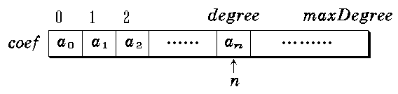
Applications of Sparse Matrices
Polynomial
Tensors in machine learning

Slide 21
Outline
Multi-array
Generalized list
Storage management
Trie

Slide 22
Generalized Lists
Review of sequential list (linear list)
A finite sequence of n (n≥0) elements
The elements have the same data type
If the elements can also be lists, the list is a generalized list (广义表)
L = (x₀, x₁, …, x_{i}, …, x_{n-1})

Slide 23
Generalized Lists
L = (x₀, x₁, …, x_{i}, …, x_{n-1})
L is the name of this generalized list
n is the length
x_{i} (0≤i<n) is a member of L
a single element (atom, 原子), or
a generalized list (sublist, 子表)
The depth of a generalized list
The level of parenthesis after writing the list with atoms

Slide 24
Generalized Lists
L = (x₀, x₁, …, x_{i}, …, x_{n-1})
Head = x₀
Tail = (x₁, …, x_{n-1})
A smaller list
Convenient for storage and implementation

Slide 25
Types of Generalized Lists
Pure list (纯表) (☐: atom; O: sublist)
There is a unique path from the root to every atom
Equivalent to tree
(x1, (y1 ,(a1 ,a2 ), y3), x3 ,(z1 ,z2))
x1
x3
y1
y3
z1
z2
a1
a2

Slide 26
Types of Generalized Lists
Reentrant list (可重入表)
whose element may appear multiple times
We label sub-lists for better presentation
L3
L1
L2
c
e
f
g
d
a
b
(L1: (a,b), (L1, c, L2: (d)), (L2, e, L3: (f, g)), L3)

Slide 27
Types of Generalized Lists
Recursive list (循环表)
whose depth is infinity
(L1: (L2: (L1, a)), (L2, L3: (b)), (L3, c), L4: (d,L4))
L1
L4
L2
L3
c
d
a
b

Slide 28
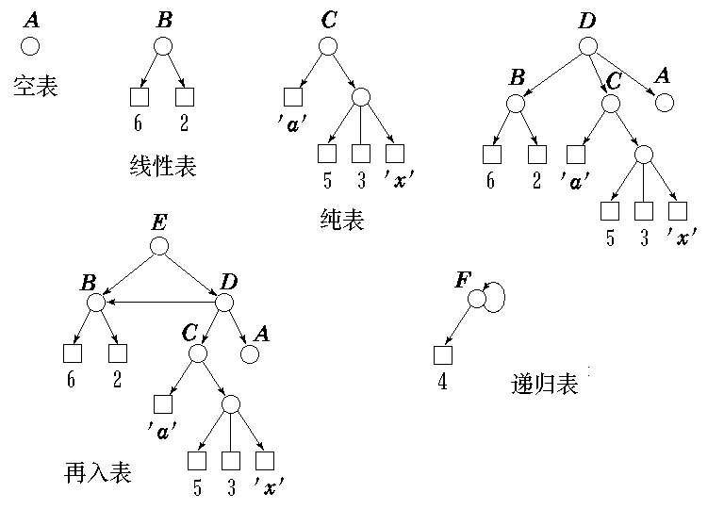
empty list
pure list
linear list
pure list
recursive list
reentrant list

Slide 29
Types of Generalized Lists
Graph ⊃ reentrant list ⊃ pure list (tree) ⊃ linear list
a generalized list is an extension of sequential lists and trees
a recursive list is a reentrant list with cycles

Slide 30
ADT of Generalized Lists
typedef enum {ATOM=0, LIST=1} TAG;
typedef struct GLNode { TAG tag; union { ElemType data;
GLNode *sublist; }; GLNode *next; };

Slide 31
Implementation: Insert and Delete
Add an empty header node for each sub-list
For simple operations

Slide 32
Implementation: Insert and Delete
Deletion in a list without header nodes
Example: delete “Data”
Look up from L1, then delete
L2 also needs update
L: ( L1: (data, D2) , L2: (L1, D1))
head
1
1
∧
finish
1
0
D1
∧
0
data
0
∧
data
D2

Slide 33
Implementation: Insert and Delete
If we have header nodes
Tag = -1: empty header
head(ref=0)
L: ( L1: (data, D2) , L2: (L1, D1))
-
1
1
1
∧
head(ref=1)
-
1
1
0
D1
∧
head(ref=2)
-
1
0
data
0
D2
∧

Slide 34
Traversal
Like graph traversal
Need to record labels of visited sub-lists

Slide 35
(
L1
:
(
L2
:
(
a
,
L1
)
)

Slide 36
(L1: (L2: (a ,L1))
,
Lx
:
(
L2
,
L3
:
(
b
)
)
,
Ly
:
(
L3
, c)
, L4
: (
d ,
L4
)
)
finish

Slide 37
Applications
Represent the function call relations
Represent the memory reference relations
LISP/scheme language
(define fib (n)
"Simple recursive Fibonacci number function"
(if (< n 2)
n
(+ (fib (- n 1)) (fib (- n 2)))))

Slide 38
Outline
Multi-array
Generalized list
Storage management
Trie

Slide 39
Storage Management
Basic functionalities
Allocate storage space
Recycle “released” space
Fragmentation
Cannot be efficiently utilized
Useless units
Space should be recycled but not yet
E.g.: not delete a pointer

Slide 40
Free List
Storage resources is an array of blocks
Some are allocated
Some are free: organized by a linked list (free list)
Allocate: find a free block, and delete from free list
Recycle: insert a block into free list

Slide 41
Example
Free list in the beginning
After running for a while

Slide 42
Application-level Memory Management
In many scenarios, applications prefer to manage memory themselves instead of asking system
Reduce overheads of system call
Approach
Maintain own free list to recycle resources
Only when no elements in free list, ask the system

Slide 43
Application-level Memory Management
template <class Elem> class LinkNode{
private:
static LinkNode *avail; // Free list: a static variable
public:
Elem value; // Node value
LinkNode * next; // Pointer to the next node
LinkNode (const Elem & val, LinkNode * p) ;
LinkNode (LinkNode * p = NULL) ;
void * operator new (size_t) ; // To overload new operator
void operator delete (void * p) ; // To overload delete operator
};

Slide 44
Application-level Memory Management
template <class Elem>
void * LinkNode<Elem>::operator new (size_t) {
if (avail == NULL) // Empty available list
return ::new LinkNode; // Call system’s new
LinkNode<Elem> * temp = avail;
// Get space from available list instead of system
avail = avail->next;
return temp;
}

Slide 45
Application-level Memory Management
template <class Elem>
void LinkNode<Elem>::operator delete (void * p) {
( (LinkNode<Elem> *) p) ->next = avail;
avail = (LinkNode<Elem> *) p;
}

Slide 46
A Perspective of Data Structure
The free list is a (linked) stack
new operator: pop from top (head of linked list)
delete operator: push to stack (head of linked list)
Note: it is necessary to call system’s “::new p” and “::delete”
Get memory at the beginning
Return all memory to system at the end

Slide 47
Variable-Length Allocation
Practical systems do not allocate a fixed-length block
Allocation
Find a block whose size is at least the applied size
Truncate the block into small ones, and return a small block
Just fit applied size
Recycle
Try to merge the recycled block with adjacent ones
For future allocation

Slide 48
Block Structure

Slide 49
Fragmentation Problem
Internal fragmentation
Allocated size a bit larger then applied size
A block is not fully used
Example: the smallest block is 1024 bytes (even after truncating)
If applying 1000 bytes, 24 bytes are wasted
External fragmentation
Small blocks in free list
Both allocation and recycle need to deal with

Slide 50
Allocation Strategies
First fit (首先适配)
Best fit (最佳适配)
Worst fit (最差适配)
No one is best in all scenarios

Slide 51
First Fit
Find the first block that satisfies applied size in free list
1200
1000
3000
600
600
500
100
900
100
2200
800
3 Blocks: 1200，1000，3000
Applied size: 600，500，900，2200

Slide 52
Best Fit
Find the smallest block that satisfies applied size in free list
1200
1000
3000
500
700
2200
600
400
900
2100
3 Blocks: 1200，1000，3000
Applied size: 600，500，900，2200

Slide 53
Worst Fit
Find the largests block that satisfies applied size in free list
1200
1000
3000
600
500
2200
2400
900
1900
1000
3 Blocks: 1200，1000，3000
Applied size: 600，500，900，2200

Slide 54
Recycle
Merge a block with its neighbours

Slide 55
Failure Policy
If we cannot allocate memory to fit an application, we can
Do nothing, return an error
Try to execute some failure policy to satisfy application

Slide 56
Failure Policy: Compact (压缩)
Move data into continuous blocks
Before
After

Slide 57
Failure Policy: Collect Useless Blocks
Examine each block
If do not own any application, add to free list
May be forget by some programs
Work with Compact

Slide 58
Outline
Multi-array
Generalized list
Storage management
Trie

Slide 59
Trie Tree
BST does not guarantee a balanced tree
The structure depends on the order of insertions and deletions
7, 5, 4, 6, 8
4, 5, 6, 7, 8

Slide 60
Trie Structure
Spatial decomposition of the key
“trie” comes from “retrieval”
Applications
Information retrieval
Large-scale dictionary in natural languages
Character Tree: 26-aray Trie
Binary Trie
Use binary code to decompose the key

Slide 61
Example: 26-ary Trie
The subtree of “an” represents the words with prefix an-: {and，ant}
Key idea: each subtree means a collection of keys with the same prefix

Slide 62
Example: 26-ary Trie
Variable-length strings: use “*” to indicate end of a string
an
,
and
,
ant
,
bad
,
bee
a
b
a
e
n
d
t
*
d
e
an
*
*
bad
bee
and
ant
*
*

Slide 63
Example: 26-ary Trie
Compact nodes without siblings
an
,
and
,
ant
,
bad
,
bee
a
b
n
a
e
*
d
t
bad
bee
an
and
ant

Slide 64







Example: Binary Trie
Elements: 2、5、9、17、41、45、63
0 (<32)
1 ($≥$32)
1 ($≥$16)
0 (<48)
1 ($≥$48)
0 (<16)
0 (<8)
1 ($≥$8)
1 ($≥$40)
17
63
0 (<4)
1 ($≥$4)
0 (<44)
1 ($≥$44)
9
2
5
41
45

Slide 65
Example: Binary Trie
Elements: 2、5、9、17、41、45、63
Compaction nodes without siblings
0
0xxxxx
1xxxxx
1
1
00xxxx
01xxxx
10xxxx
11xxxx
2
17
2
63
000xxx
001xxx
101xxx
3
9
3
0000xx
1010xx
1011xx
0001xx
2
5
41
45

Slide 66
Compression Technique: PATRICIA Structure
“Practical Algorithm To Retrieve Information Coded In Alphanumeric”
A variant of Trie by D. Morrision
Decompose the binary code of keys
A compact, binary trie

Slide 67
Properties of Tries
There is a unique trie for any given set of keys
The linked structure (shape) of a trie is independent of the key insertion/deletion order
Different from other search tree structures

Slide 68
Properties of Tries
Worst-case time bound for search & insert
The number of pointer (array) accesses when searching in a trie is at most 1 plus the length of the key
Tries are efficient for search hit
It does not depend on the number of keys
Notes:
Comparison with hash table.
O(1) insertion and search for hash table, only when hash function takes O(1) time.
In practice, hash a string of length k takes O(k) time.
PATRICIA guarantee a O(k) worst-case time.

Slide 69
Properties of Tries
Average-case time bound for search miss
The average number of nodes examined for search miss in a trie built from N random keys over an alphabet of size R is ~ log_{R}N
Search miss does not depend on the length of searched key
For example, a search miss in a trie with 1 million random keys only needs to examine 3-4 nodes

Slide 70
Properties of Tries
Space
The number of nodes in a trie is at most Nw
N: number of keys
w: the average key length
Each node contains R pointers to its children
Space usage is high for large number of long keys taken from large alphabets
Each node maintains a table of alphabets for quick lookup
If you can afford the space, trie performance is difficult to beat

Slide 71
Application: Suffix Tree
Goal: store all suffix of a string
A compressed Trie
Example: “ababc”
ababc, babc, abc, bc, c
a
b
c
ab
c
b
b
ab
b
ab
a
a
b
c
c
c
c
c
c
b
b
abc
abc
c
abc
c
bc
abc
bc
ababc
babc
ababc
babc
Trie of suffix
Suffix Tree

Slide 72
Application: Suffix Tree
We can easily compute common prefix among all suffixes
Example:
Suffix Array: starting position of suffix
5 | ALAM$
1 | ALAYALAM$
7 | AM$
3 | AYALAM$
6 | LAM$
2 | LAYALAM$
0 | MALAYALAM$
8 | M$
4 | YALAM$
9 | $
M A L A Y A L A M $
0 1 2 3 4 5 6 7 8 9
A
LA
M
YALAM$
LA
YALAM$
M$
YALAM$
4
M$
$
ALAYALAM$
M$
7
3
6
2
YALAM$
0
8
5
1

Slide 73
Application: Suffix Tree
5 | ALAM$
1 | ALAYALAM$
7 | AM$
3 | AYALAM$
6 | LAM$
2 | LAYALAM$
0 | MALAYALAM$
8 | M$
4 | YALAM$
9 | $
M A L A Y A L A M $
0 1 2 3 4 5 6 7 8 9
Start of Suffix
5 | 1 | 7 | 3 | 6 | 2 | 0 | 8 | 4 | 9
Size of Longest Common Prefix
3 | 1 | 1 | 0 | 2 | 0 | 1 | 0 | 0 | -
Suffix 5 and 1 have common prefix “ALA”
Suffix 1 and 7 have common prefix “A”
LCP are always generated by neighboring suffix

Slide 74
Application: Suffix Tree
D = 0
A
5 | ALAM$
1 | ALAYALAM$
7 | AM$
3 | AYALAM$
6 | LAM$
2 | LAYALAM$
0 | MALAYALAM$
8 | M$
4 | YALAM$
9 | $
LA
M
YALAM$
D = 1
D = 2
D = 3
LA
YALAM$
M$
YALAM$
4
M$
$
ALAYALAM$
M$
7
3
6
2
YALAM$
0
8
5
1
5 | 1 | 7 | 3 | 6 | 2 | 0 | 8 | 4 | 9
Suffix
3 | 1 | 1 | 0 | 2 | 0 | 1 | 0 | 0 | -
LCP

Slide 75
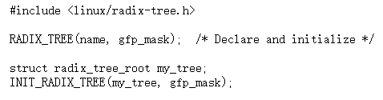
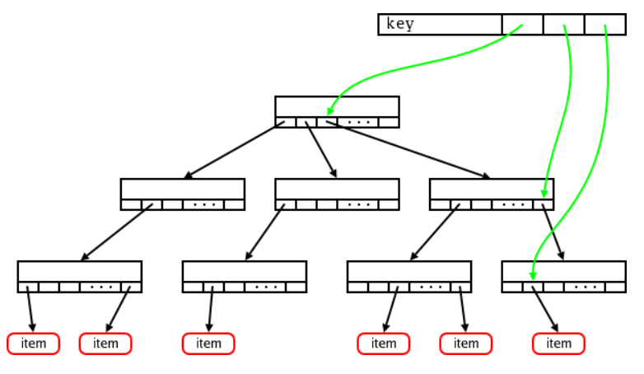

Trie in Linux
Called Radix Tree
Usage: lookup memory page of a given address

Slide 76
Summary
Multi-array
Generalized list
Storage Management
Trie

